Slide 1

Photo by Julia Wimmerlin
“Hong Kong by night”
Information Retrieval
Notes:
Hello everyone, thank you for coming today for our tutorial about user interest modeling in online social networks.
And this brilliaint photo is by Julia Wimmerlin. (My crazy hike with full gear and no model in sight was rewarded with this self-portrait at the most electric background I&#39;ve ever seen. Beautiful Hong Kong by night)

Slide 2
Information Retrieval
Human
Information Need

Slide 3
Information Retrieval
Information
Human
Information Need
Relevant Information

Slide 4
Information Retrieval: Library
Library
Mainly Documents
Relevant Information
Human
Information Need
Librarian
Search
Relevant Information

Slide 5
Information Retrieval: Library
Library
Mainly Documents
Relevant Information
Human
Information Need
Index
Search
Relevant Information

Slide 6
Information Retrieval: Library
Relevant Information
Library
Mainly Documents
Librarian
Human
Information Need
Which one?
Index
Relevant Information

Slide 7
Information Retrieval: Library
Relevant Information
Library
Mainly Documents
Librarian
Human
Information Need
Dialog
Personalization
Index
Relevant Information

Slide 8
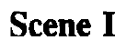
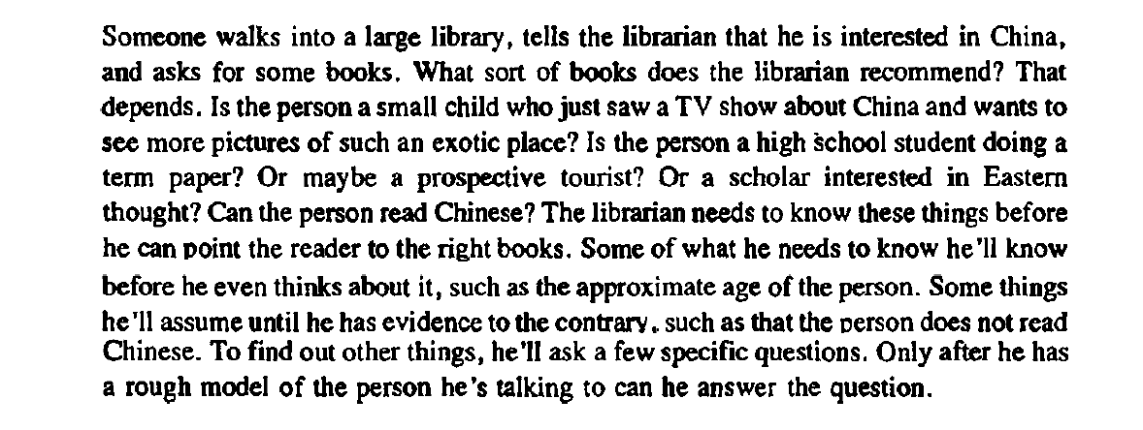
Notes:
Someone walks into a large library, tells the librarian that he is interested in China. and asks for some books. What sort of books does the librarian recommend?
That depends!
Is the person a small child who just saw a TV show about China and wants to see more pictures of such an exotic place?
Is the person a high School student doing a term paper? Or maybe a prospective tourist? Or a scholar interested in Eastern thought?
Can the person read Chinese?
The librarian needs to know these things before he can point the reader to the right books.
Some of what he needs to know he'll know before he even thinks about it, such as the approximate age of the person. ➔ explicit
Some things he'll assume until he has evidence to the contrary., such as that the person does not read Chinese. ➔ Default
To find out other things, he'll ask a few specific questions. ➔ Inference
Only after he has a rough model of the person he's talking to can he answer the question

Slide 9
Information Retrieval: Library
Relevant Information
Library
Mainly Documents
Librarian
Human
Information Need
Monolog
Index
one size, fits all!
Relevant Information

Slide 10
Information Retrieval: Librarian vs. Index
Language Gap
Information Need vs. Information Content
“lost bullet” vs. “stray bullet”
User Model
Neural Network
Biologist vs. Computer Scientist
Temporal Language Model
Gay
Cheerful vs. Homosexual man

Slide 11
Information Retrieval: Village
Village
Human
Information Need
Relevant Person

Slide 12
Information Retrieval
Library
Classic Search
Human
Information Need
Village
Social Search

Slide 13
Information Retrieval: Query
Query
formal statements of information need
mostly in text!
Library
query
Human
Information Need
Village
query

Slide 14
Information Retrieval: Today
1. Query
2. Relevance (Query, Information)
Human
Information Need
Index
+
Librarian
Information
4. Show Top Relevant Information
3. Fetch Top Relevant Information

Slide 15
Information Retrieval: Process
Relevance
Boolean (AND, OR, …): include the query items
Vector Space: Similarity(Query Vector Rep., Info. Vector Rep.)
…
1. Query
2. Relevance (Query, Information)
Human
Information Need
Index
+
Librarian
Information
4. Show Top Relevant Information
3. Fetch Top Relevant Information

Slide 16
Information Retrieval: Query
Relevance
Boolean (AND, OR, …): include the query items
Vector Space: Similarity(Query Vector Rep., Info. Vector Rep.)
…
1. Query
2. Relevance (Query, Information)
Human
Information Need
Index
+
Librarian
Information
4. Show Top Relevant Information
3. Fetch Top Relevant Information

Slide 17
Information Retrieval: Query
Query → Refined Query
User Model: a query by a biologist
Temporality: a query at year 2021
Language Gap: by “lost bullet” user means “stray bullet”
Autocorrection: by “precisn” user means “precision”
…
1. Query
2. Relevance (Refined Query, Information)
Human
Information Need
Index
+
Librarian
Information
4. Show Top Relevant Information
3. Fetch Top Relevant Information

Slide 18
Query Refinement

Slide 19
Information Retrieval: Query Refinement
Query Refinement
Expansion: adding new words to original query
Reduction: removing words of original query
Replacement: replacing words of original query
Mixed → Pipeline of Changes

Slide 20
Learn to Refine Query

Slide 21
Supervised Query Refinement

Slide 22
Supervised Query Refinement
Given a training set of pairs of (q, q’)
q’ = Refined(q)
q’ retrieves more relevant information
q’ retrieves more relevant information in order
We can train a translation from q to q’:
seq2seq model
seq2seq model with attention

Slide 23
Supervised Query Refinement
Given a training set of pairs of (q, q’)
q’ = Refined(q)
q’ retrieves more relevant information
q’ retrieves more relevant information in order
Information Need: “a bullet that hit a person unintentionally”
q: “lost bullet” | q’: “stray bullet” | Relevant Information in order of relevance
D4 | D1 | D1
D2 | D3 | D2
D9 | D4 | D3
D7 | D8 | D4

Slide 24
Supervised Query Refinement
Metrics
Set Retrieval: classification of relevant vs. non-relevant
Precision, Recall, F-measure, Success (Hit) ratio
Ranked Retrieval
RR, AP, nDCG
Relevance Judgment
q: “lost bullet” | q’: “stray bullet” | Relevant Information in order of relevance
D4 | D1 | D1
D2 | D3 | D2
D9 | D4 | D3
D7 | D8 | D4

Slide 25

Supervised Query Refinement
Metrics
Set Retrieval: classification of relevant vs. non-relevant
Precision, Recall, F-measure, Success (Hit) ratio
Ranked Retrieval
RR, AP, nDCG
q: “lost bullet” | q’: “stray bullet” | Relevant Information in order of relevance
D4 | D1 | D1
D2 | D3 | D2
D9 | D4 | D3
D7 | D8 | D4
https://ils.unc.edu/courses/2013_spring/inls509_001/lectures/10-EvaluationMetrics.pdf

Slide 26
Supervised Query Refinement
Given a training set of pairs of (q, q’)
From where?
Manual creation of dataset.
Automatic creation of dataset!
Users Search Sessions & Click-through
ReQue

Slide 27
Supervised Query Refinement
Automatic creation of dataset!
Users Search Sessions & Click-through
Scenario:
- Within a short time period
- User tries to find relevant information until she satisfies

Slide 28
Supervised Query Refinement
Automatic creation of dataset!
Users Search Sessions & Click-through
Scenario:
- Within a short time period
- User tries to find relevant information until she satisfies
1- Start with a naïve query about her information need

Slide 29
Supervised Query Refinement
Automatic creation of dataset!
Users Search Sessions & Click-through
Scenario:
- Within a short time period
- User tries to find relevant information until she satisfies
1- Start with a naïve query about her information need
2- If she sees relevant information, she clicks on it
The truth about relevance and its order are captured by the user!

Slide 30
Supervised Query Refinement
Automatic creation of dataset!
Users Search Sessions & Click-through
Scenario:
- Within a short time period
- User tries to find relevant information until she satisfies
1- Start with a naïve query about her information need
2- If she sees relevant information, she clicks on it
3- She refine the query to find more relevant information

Slide 31
Supervised Query Refinement
Automatic creation of dataset!
Users Search Sessions & Click-through
Conversational Search

Slide 32
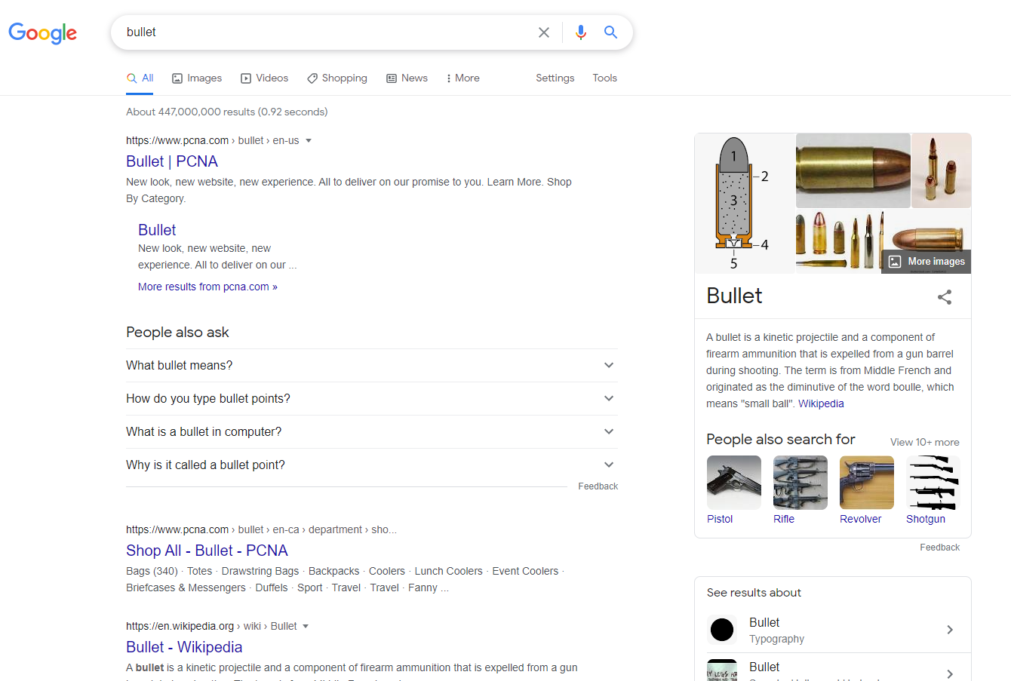
Supervised Query Refinement

Slide 33
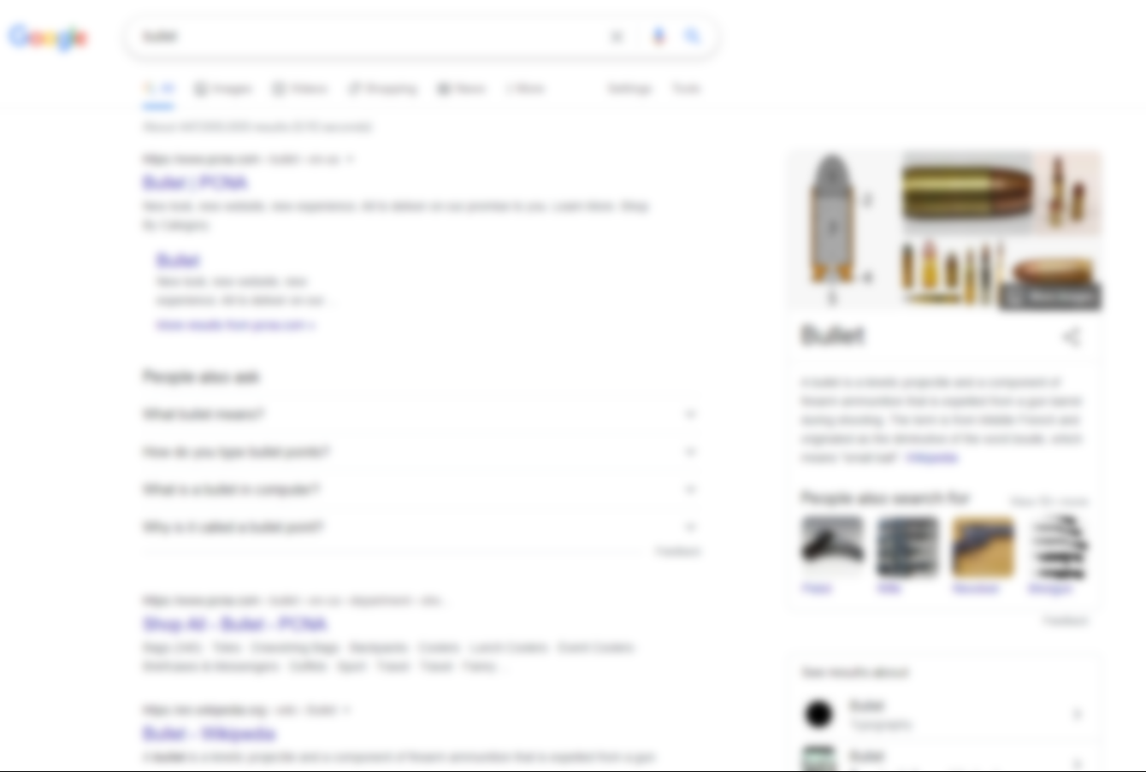
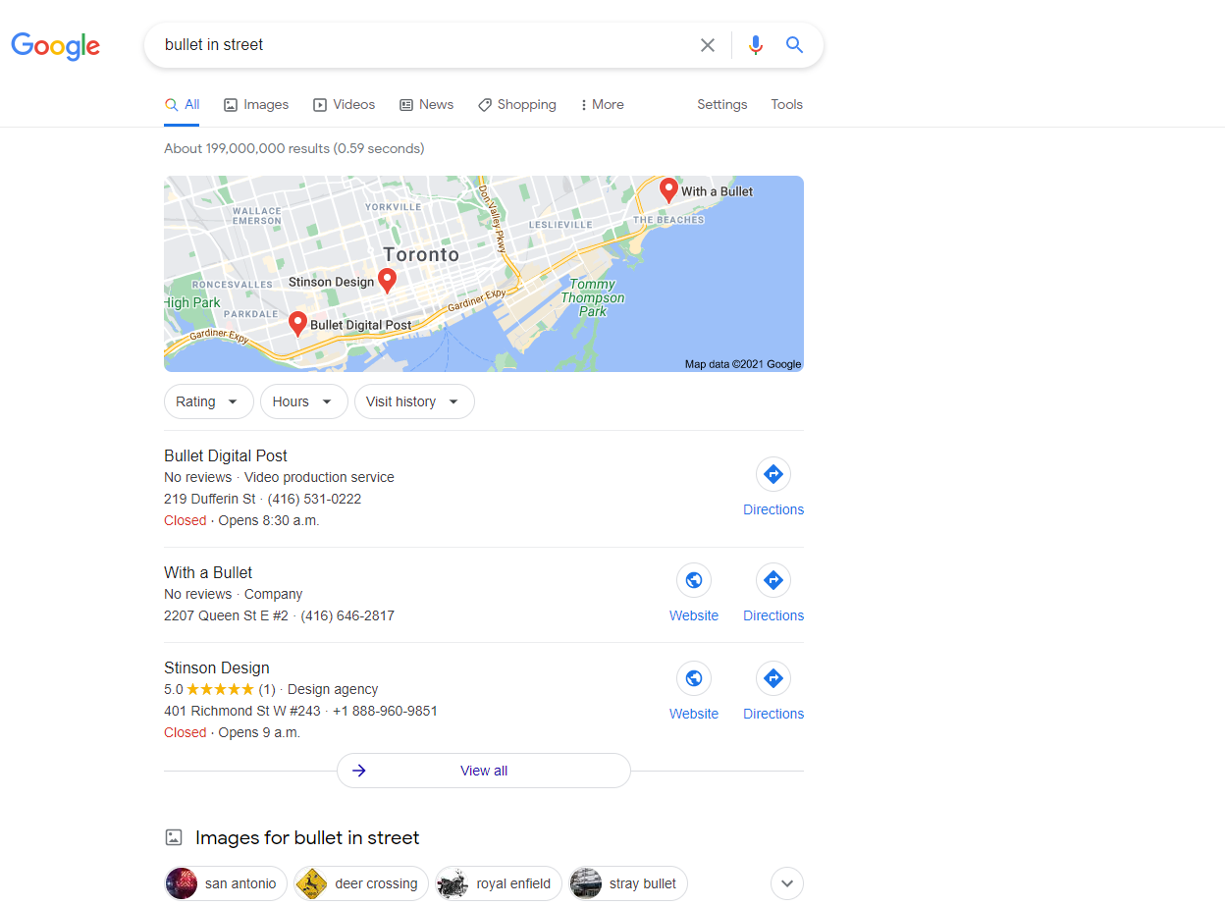
Supervised Query Refinement

Slide 34

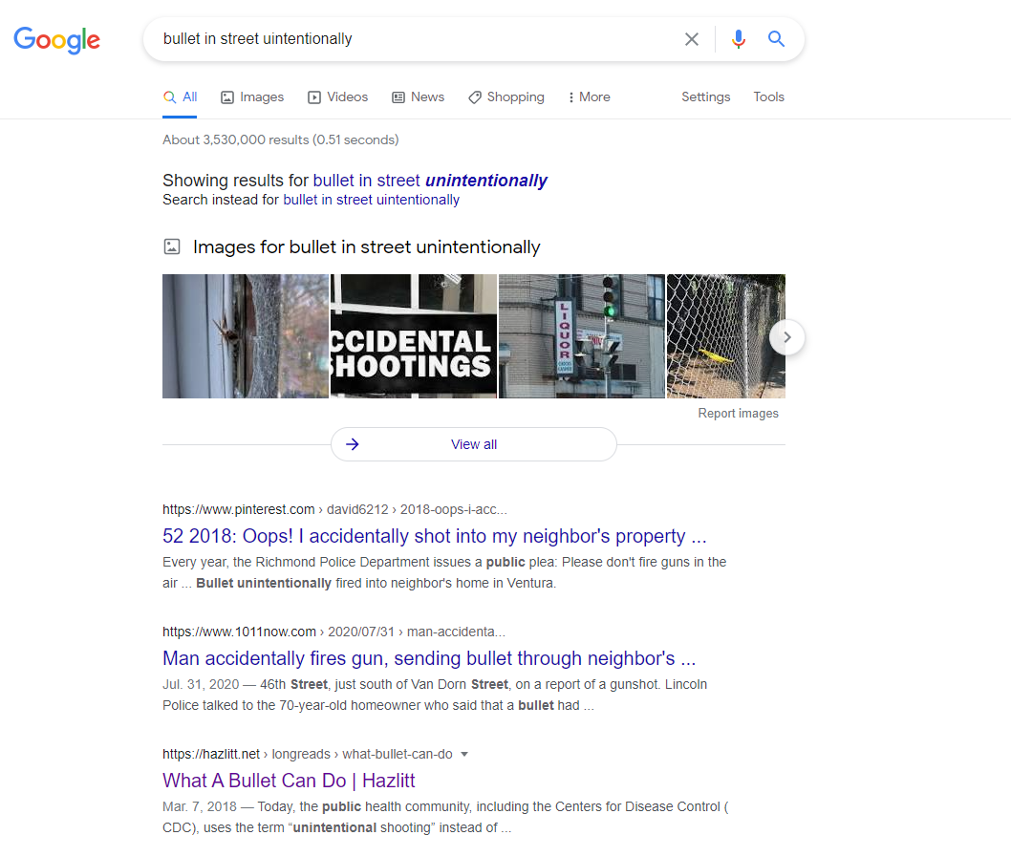
Supervised Query Refinement

Slide 35
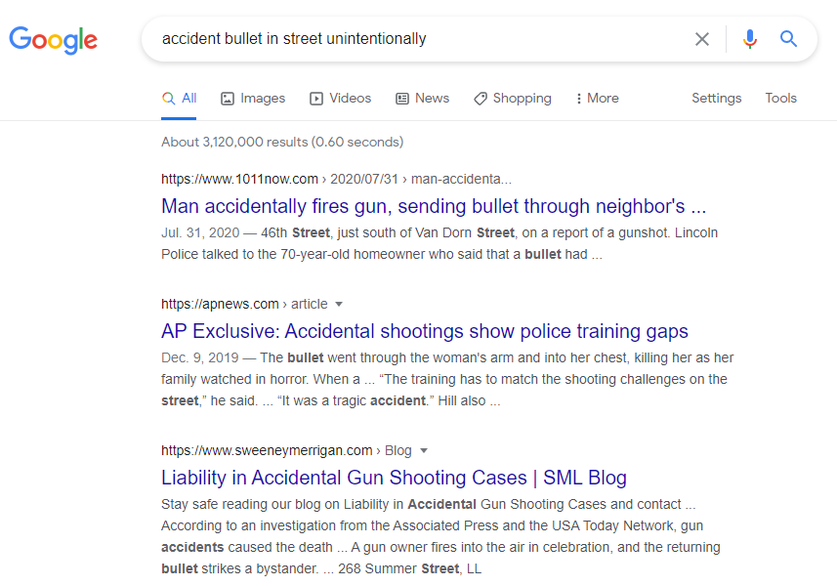

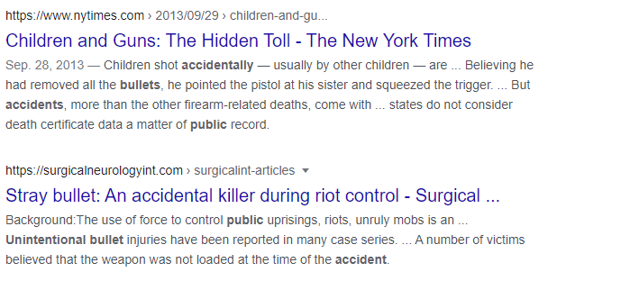
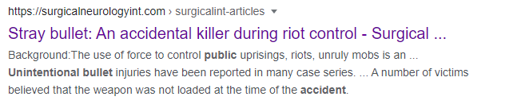
Supervised Query Refinement

Slide 36

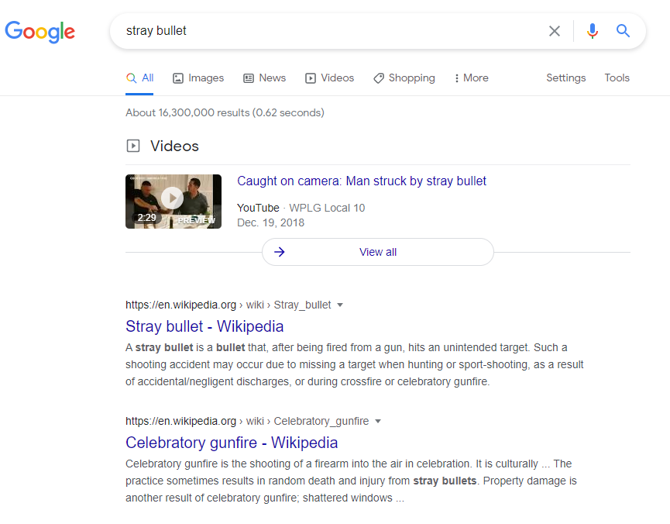


Supervised Query Refinement

Slide 37
Supervised Query Refinement
Automatic creation of dataset!
Users Search Sessions & Click-through
The first query → q
The last query → q’
We assume the retrieve information for q’ is better than q. Why? Because the user quit the search!

Slide 38

Supervised Query Refinement
Automatic creation of dataset!
Users Search Sessions & Click-through
AOL
MSMARCO

Slide 39
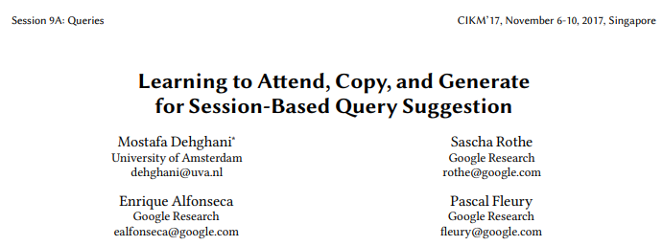
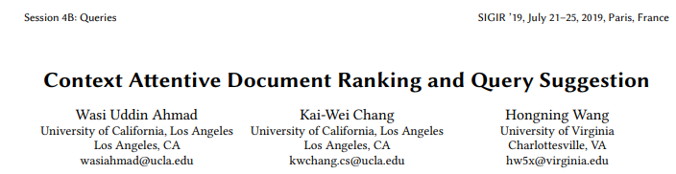
Supervised Query Refinement

Slide 40
Supervised Query Refinement
Automatic creation of dataset!
Users Search Sessions & Click-through
The first query → q
The last query → q’
We assume the retrieve information for q’ is better than q. Why? Because the user quit the search!
was she satisfied when quit?!

Slide 41
Supervised Query Refinement
Automatic creation of dataset!
Users Search Sessions & Click-through
The first query → q
The last query → q’
We assume the retrieve information for q’ is better than q. Why? Because the user quit the search!
Topic Drift!

Slide 42
Supervised Query Refinement: Topic Drift
Automatic creation of dataset!
Users Search Sessions & Click-through
# | Session Queries
1 | [is sicily part of italy]→[is sri lanka part of africa]→[what are the maldives]→[what is great barrier reef]→[what is tanzania]
2 | [immutable, definition]→[define obliged]→[meaning of industrious]→[what do vocation mean]→[legal definition capricious]→[definition of. contempt]→[definition of famine]→[meaning of obstinate]
3 | [what is google classroom]→[synonym for commotion]→[missionaries definition]→[intersect definition]→[types of intersecting lines]→[stimulus value definition]→[definition of system unit] →[destruction of lesions definition]→[touch definition]→[top load washer machine]
4 | [definition tangible]→[define translucent]→[astringent define]→[definition of retribution]→[define defined contribution]
5 | [are great white shark endangered]→[german shepherd/labrador]→[australian shepherd price] [longevity of boston terrier]→[cost for cairn terrier]→[is chihuahua a dog]

Slide 43
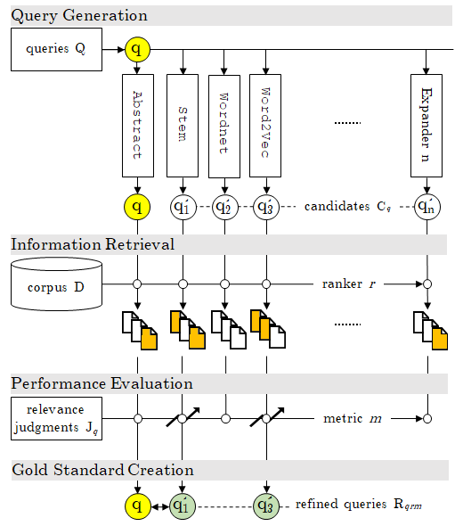
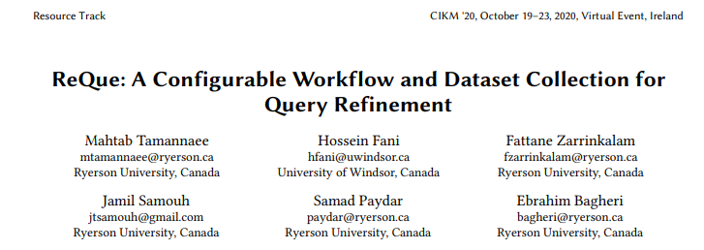
Supervised Query Refinement
Automatic creation of dataset!

Slide 44
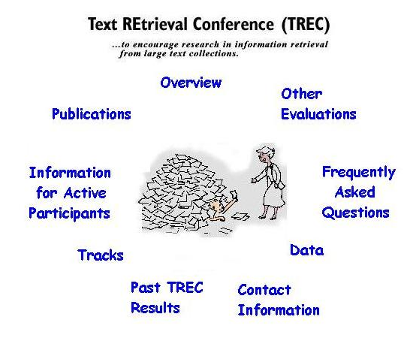
Supervised Query Refinement
Automatic creation of dataset!
ReQue
https://trec.nist.gov/

Slide 45
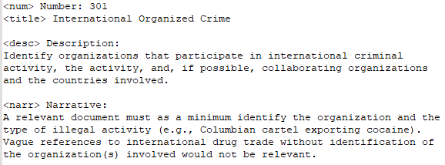
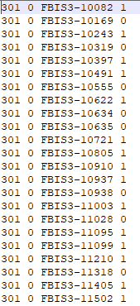
Supervised Query Refinement
Automatic creation of dataset!
ReQue
Robust04
Clueweb
Gov

Slide 46
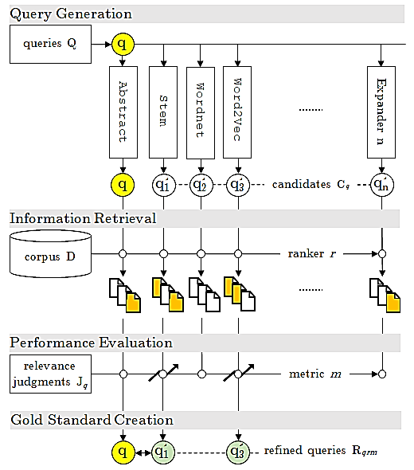
Supervised Query Refinement
Automatic creation of dataset!
ReQue
Create collection of variations to q

Slide 47
Supervised Query Refinement
Automatic creation of dataset!
ReQue
Try to retrieve the relevant information

Slide 48
Supervised Query Refinement
Automatic creation of dataset!
ReQue
Evaluate the retrieved information

Slide 49
Supervised Query Refinement
Automatic creation of dataset!
ReQue
Those that increase the performance are the refined queries!
There may be more than 1.

Slide 50
Supervised Query Refinement
Automatic creation of dataset!
ReQue
The improvement for q’ is guaranteed!
We should train the models on this dataset.

Slide 51
Unsupervised Query Refinement
Creating collection of variations to q
Brute-force change to q
Guided change to q

Slide 52
ReQue
Unsupervised Query Refinement
Stem
Thesaurus
n-gram LM
Neural LM
…

Slide 53
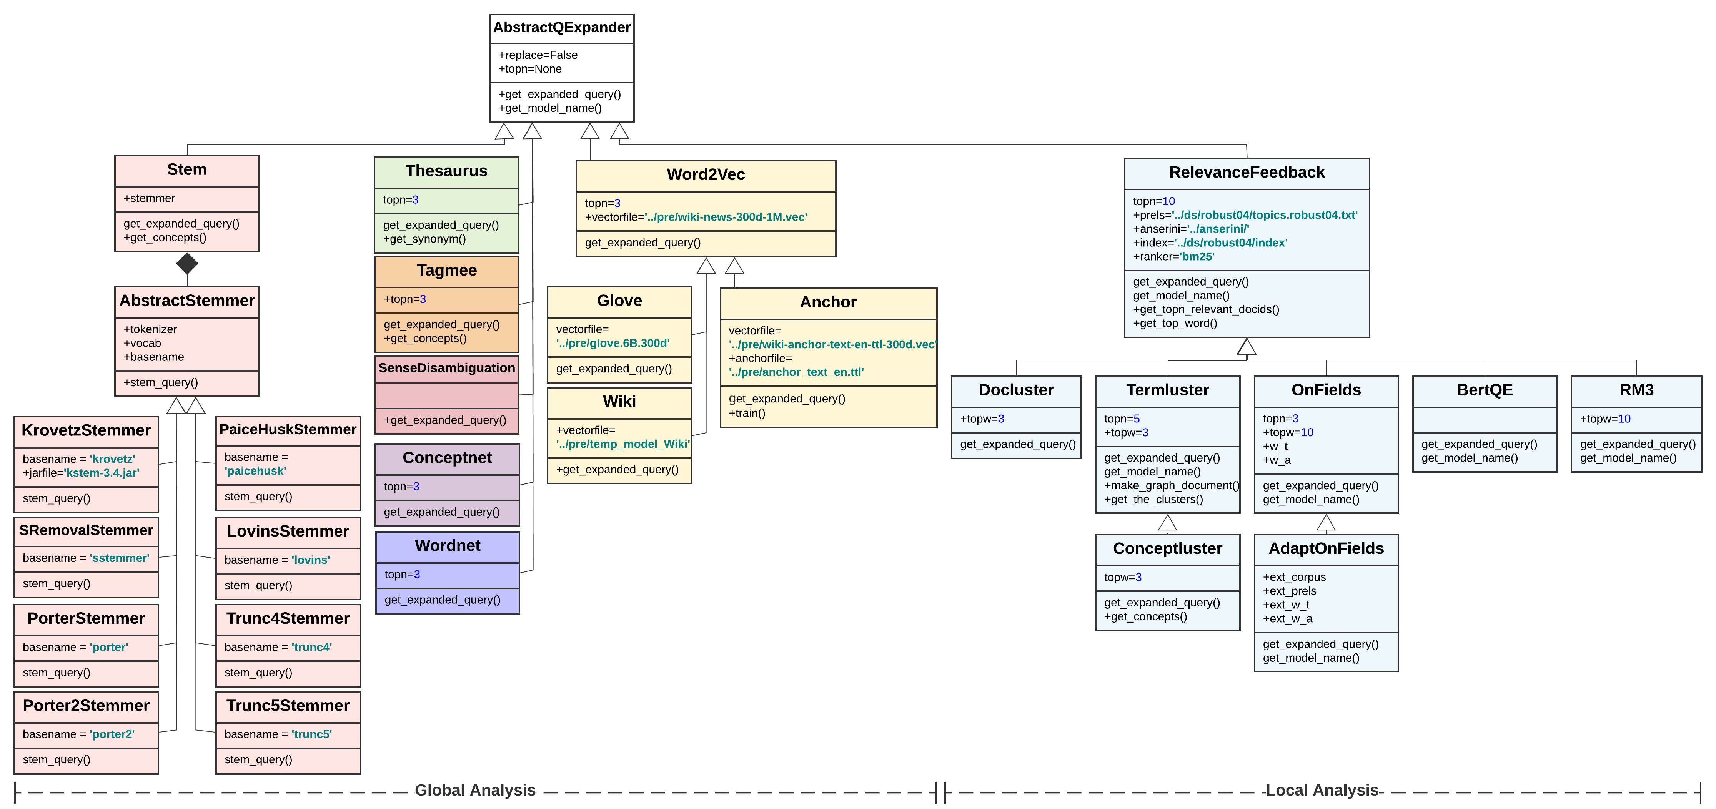
ReQue

